Slide 1
Tencent Open Source - Community Practice and Roadmap
Junping Du
Chairman of Tencent Open Source Alliance
Apache Member

Slide 2

Personal information
Junping Du
Chairman of Tencent Open Source Alliance, and Member of Open Source Management Committee
The Head of Mass Storage & Computing of Tencent Big Data
The Expert Researcher of Tencent Cloud
Apache Member
Apache Hadoop Committer & PMC

Slide 3
Brief history of Tencent Open Source
Internal open source screening mechanism established
Independent open source of 20 high-quality projects
2012-2015 From internal to external
2017 Rapid growth
2019+ Communities + business
2016 Compliance procedures
2018 Community governance
Open source compliance procedures improved
High-quality open source projects output continuously
Community contributions to open source communities
Commercial modes established
Open source community ecosystem co-constructed together with developers
Notes:
The Tencent Open Source is developed internally first and then externally. The Tencent Open Source advocates the "open, shared, cooperative" R&D mode as well as the wide application of internal high-quality projects across teams, departments and businesses through concepts and habit training, laying a foundation for external open source. Since 2016, Tencent has continuously released its internal open source high-quality projects on GitHub, gradually enabling open source to develop rapidly.

Slide 4
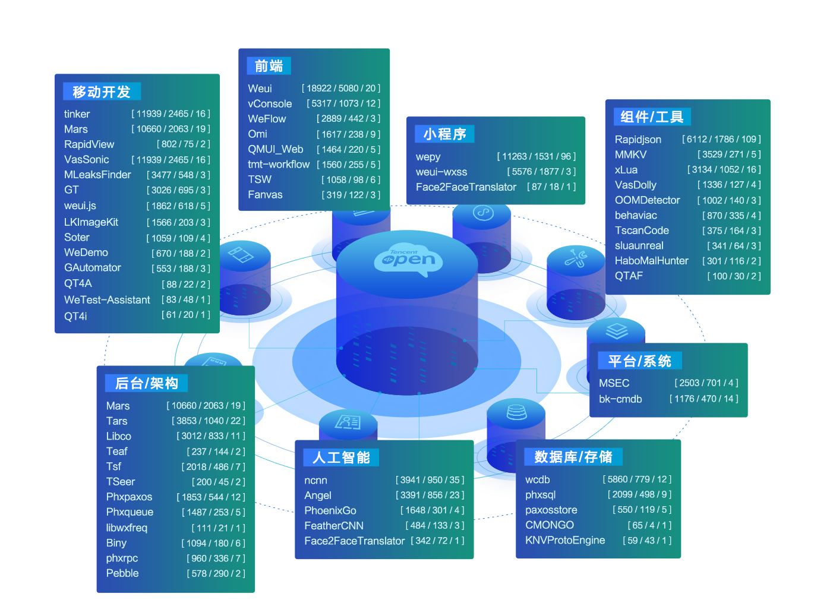
Overview of Tencent Open Source projects
Open source projects:
73
Contributors:
600
Stars:
220,000+
Notes:
Up to now, a total of 70 Tencent projects have become open source projects, involving cloud computing, Tencent Games, Tencent AI, Tencent Security, mini programs, etc.
These are open externally through numerous Tencent star businesses and massively-tested projects.
They have won nearly 220,000 stars on GitHub and wide attention and recognition in the technology circle.

Slide 5
Open source projects & community interactions
Open source projects | Issue | Issue opening ratio
wepy | 1178 | 31%
rapidjson | 810 | 30%
tinker | 796 | 7%
weui | 508 | 14%
mars | 366 | 15%
ncnn | 339 | 27%
bk-cmdb | 331 | 22%
xLua | 328 | 3%
wcdb | 282 | 21%
weui.js | 328 | 19%
Open source projects | PR | PR opening ratio
rapidjson | 471 | 5%
wepy | 274 | 6%
bk-cmdb | 246 | 0.8%
weui | 222 | 3%
angel | 114 | 0.8%
VasSonic | 96 | 0
ncnn | 88 | 1.3%
TSW | 80 | 0
vConsole | 60 | 0
xLua | 60 | 1.6%
Notes:
Tencent's independent open source projects have maintained good interactions with communities, with a very high closure ratio of issues or PRs. Tencent developers make an active response to problems raised by others and continuously inspire confidence and participation of community developers in projects, helpful for project co-construction. For Tinker, an open source project of WeChat terminal, a new version is released every month on average, and more than 99% of issues are solved. For the technological infrastructure Tars, a new version is released every 2 months on average. Cloud received 113 pieces of commit, 32 PRs and 119 issues in half a year.

Slide 6








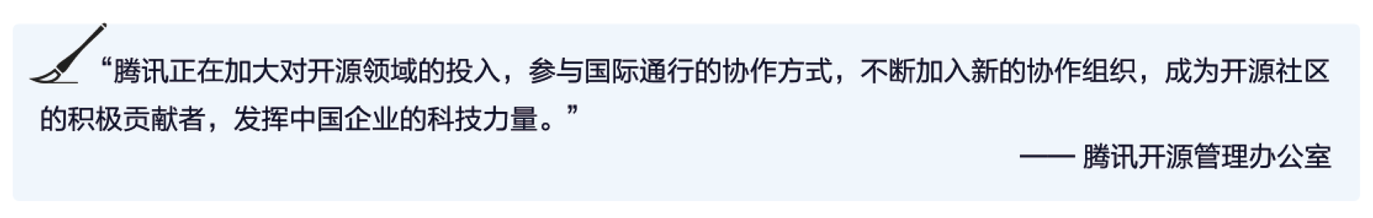

Participation in open source communities
Tencent is increasing its investment in the open source field, participating in internationally-accepted ways of collaboration, and constantly joining new collaborative organizations to become an active contributor to the open source community and to leverage the technological power of Chinese companies.
-- Tencent Open Source Management Office
Notes:
In addition to independent open source projects, Tencent also makes active interactions with international open source communities, increased investment in open source, and participation in collaboration in a common international mode, making itself become an active contributor of open source communities to allow technologies from Chinese enterprises to serve the whole world.

Slide 7

Contributions to open source communities
Linux
Linux Foundation, LF Deep Learning Platinum Member (2019)
CNCF Golden Member (2019)
Linux donated by TARS and TSeer to initiate incubation (2018)
LF Deep Learning donated by Angel to initiate incubation (2019)
46 patches contributed by Tencent Cloud to KVM's kernel
Apache
Apache Software Foundation Platinum Member (since 2018)
Hadoop 2.8.4, 2.8.5, Spark 2.3.2 released under the its leadership
The core contributor of multiple projects, including Hadoop, Spark, Flink, HBase, Hive, MXNet and Parquet
OpenStack
OpenStack Foundation Platinum Member (2018)
OpenStack Super User (2017)
MariaDB
MariaDB Foundation Platinum Member (2018)
The four core features accumulated of Tencent Games TenDB have been integrated into the mainline version of MariaDB.
Tencent is increasing its investment in the open source field, participating in internationally-accepted ways of collaboration, and constantly joining new collaborative organizations to become an active contributor to the open source community and to leverage the technological power of Chinese companies.
-- Tencent Open Source Management Office
Notes:
In addition to independent open source projects, Tencent has also actively participated in the construction of open source communities at home and abroad by donating projects and patches, outputting industry standards, etc., making itself become an active contributor of open source communities.
Meanwhile, we are also trying to continuously maintain projects through communities and commercialization.

Slide 8
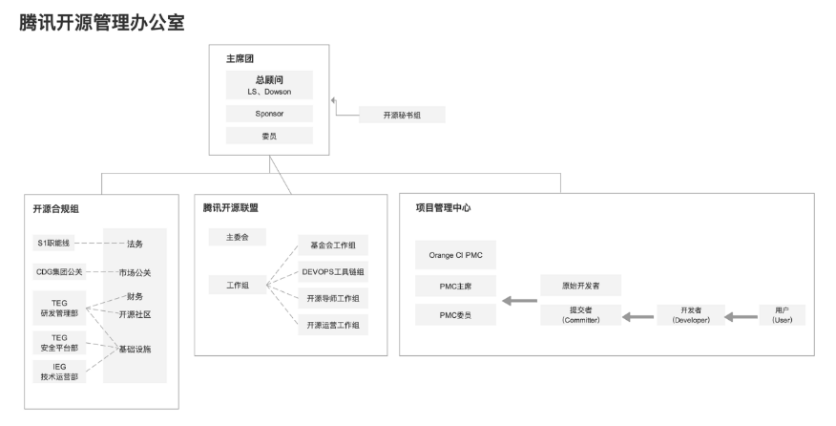

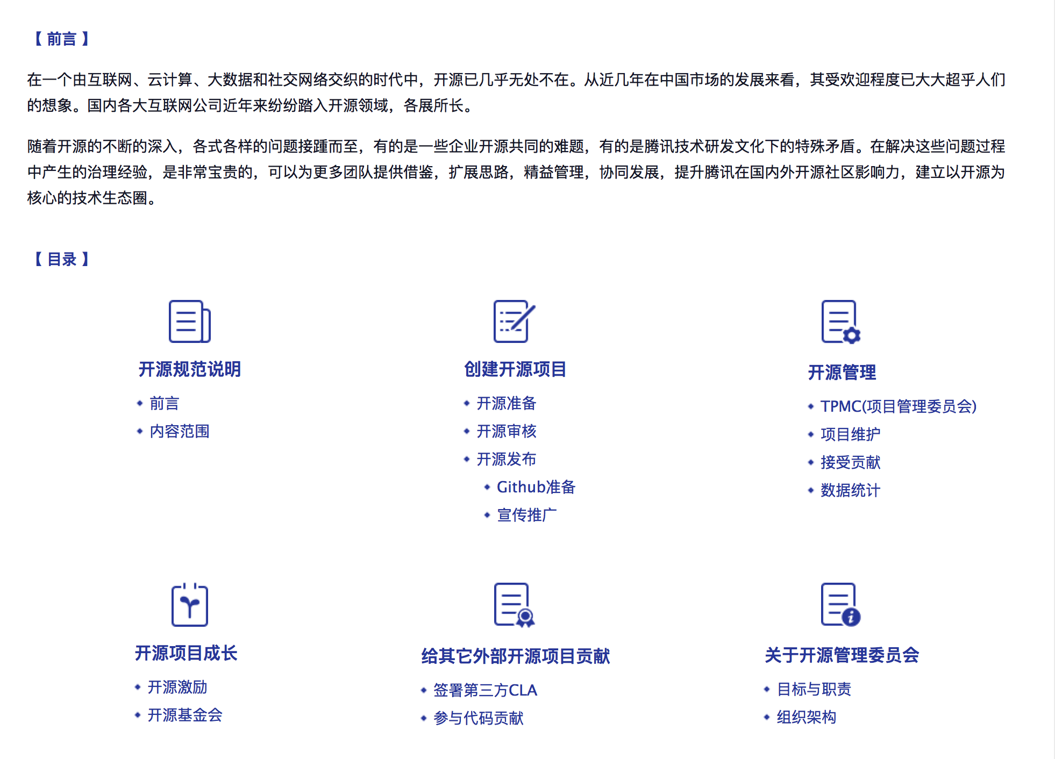
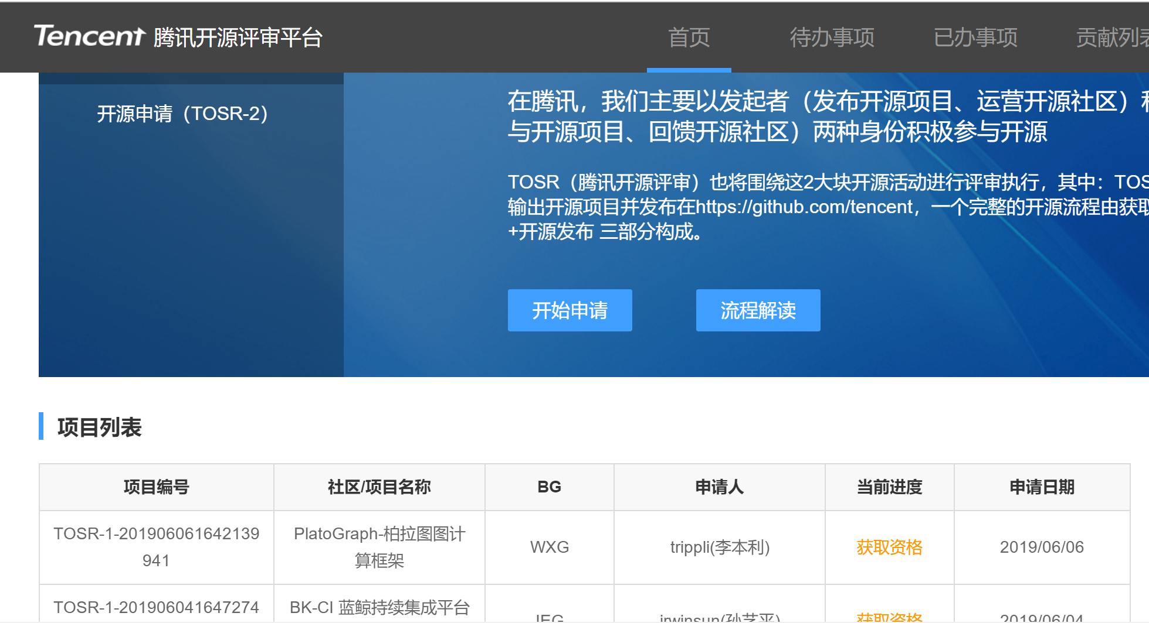
Open source governance improved by supporting mechanisms
Notes:
In Tencent, the organizational structures, specifications and platform tools for open source governance give a mature support for the whole process, from internal to external output of open source. They present a clear policy on internal and external open source. They are helpful in exploring the implementation of Tencent's open source technology ecosystem, incubating high-quality independent open source projects, and cooperating with open source foundations/open source communities at home and abroad to get effective returns.

Slide 9
Roadmap of Tencent Open Source
Intra-department small-team collaboration
Inter-department large-team collaboration
Internal contributors (majority) + external contributors (minority)，
Relative balance between internal and external contributions
Community governance, operated by a third-party foundation，
Key nodes
Community operation
3
Open community governance
Codes open
2
External codes open
Large-scale promotion & application of technologies
Developer ecosystem constructed
Community leaders and their leadership cultivated
Optimized allocation of R&D resources in the whole society
Technologies popularized
Ecosystem improved
Community influence
Division of labor in society
Evolution path
Internal open source collaboration
Design & code structure optimized
Implementation scenarios developed
External contributors' resources utilized
Technological influence constructed
Technologies optimized
Complete scenarios
Resources integrated
Influence enhanced
1
Connect organizations to facilitate collaboration，
Internal resource allocation optimized
Advantages gathered to seek for technological breakthroughs，
Collaboration promoted
Resources allocated
Technological breakthroughs
IaaS
Containers and cloud native
Database
Big data & AI
Middleware
IOT/edge computing
Mini program ecosystem
Major fields
Direction of development
From isolation to collaborative openness and then to open community governance

Slide 10

Tencent Open Source
Innovative, shared, open, and win-win

